Slide 1
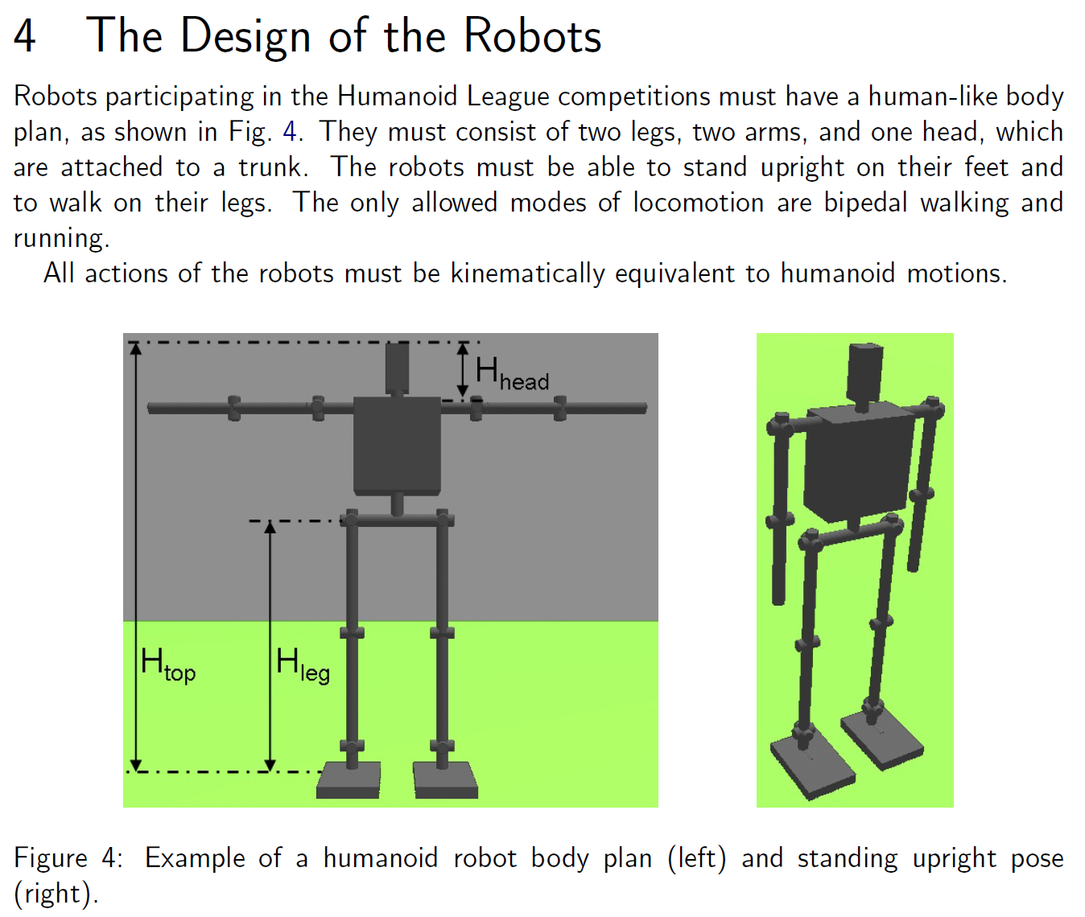
The quotations refer to the latest version of the HL rule book (version of October 2012) available from http://www.tzi.de/humanoid/bin/view/Website/Downloads
The purpose of the robot design rules in the humanoid league is to ensure a “human-like body plan”.

Slide 2
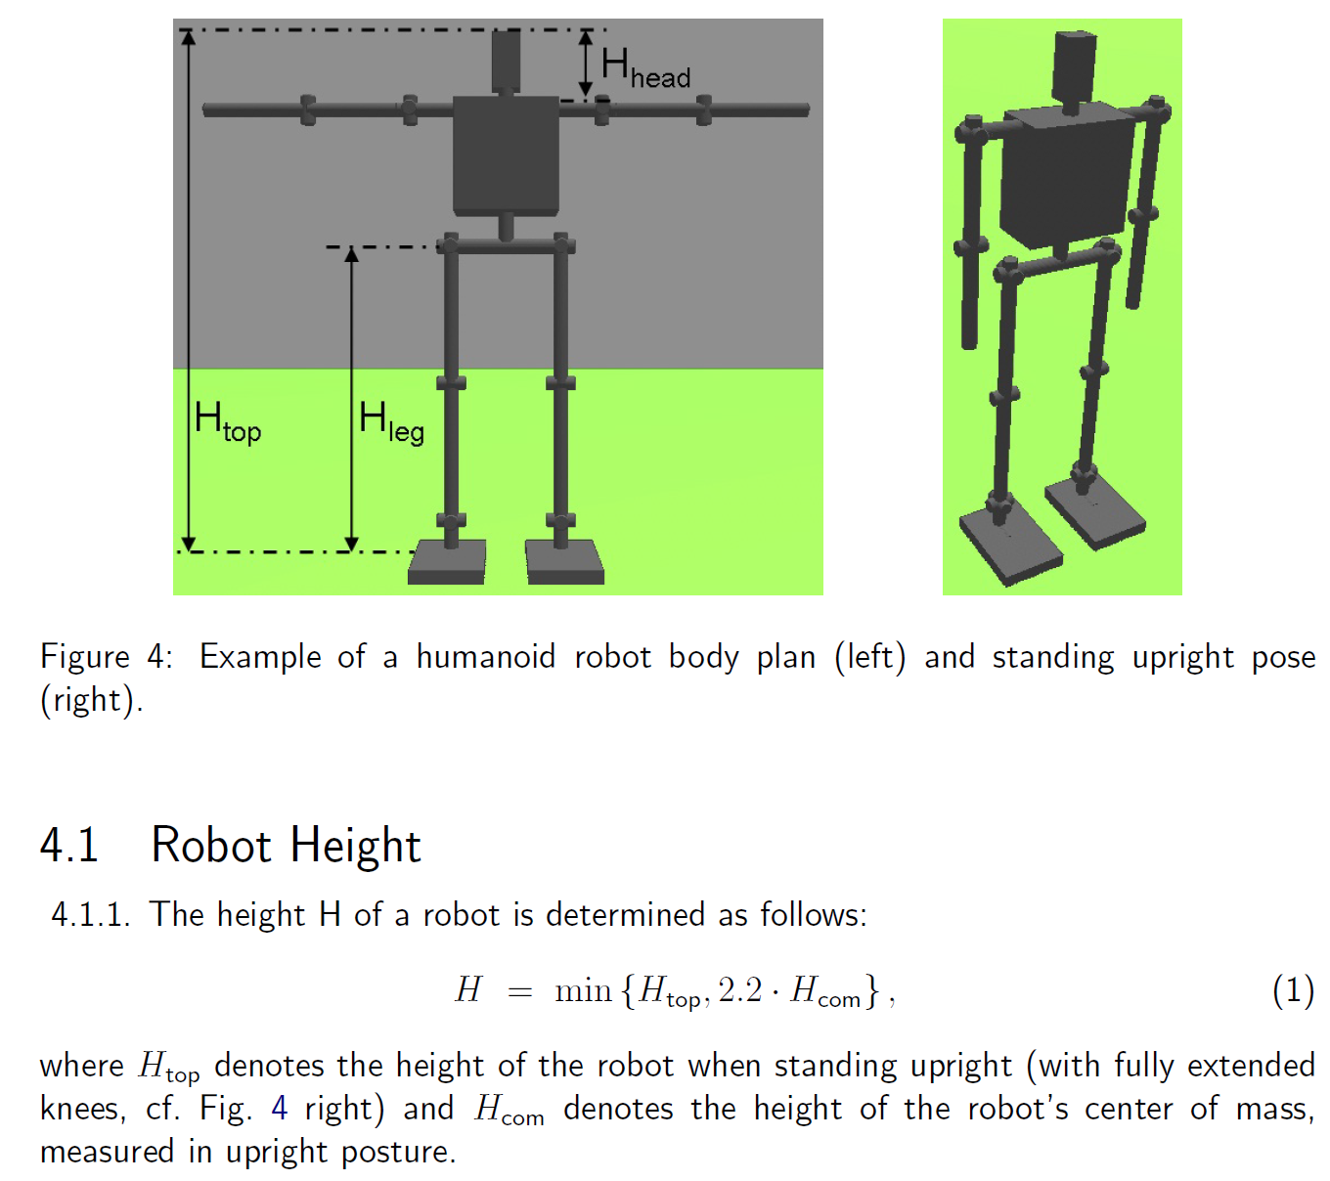
Relation 4.1.1 was introduced for the first time in 2006 and used since then “as is”. It links the kinematic robot height H_{top} to the distribution of mass by H_{com}. One goal of the design rules is to ensure “well proportioned” humanoid robots.
However, a recent comparison with human data reveals that the corresponding relation in average human adults is
H_{top} = 1.82 x H_{com} (resp. H_{com} = 0.55 x H_{top})
see http://hypertextbook.com/facts/2006/centerofmass.shtml

Slide 3
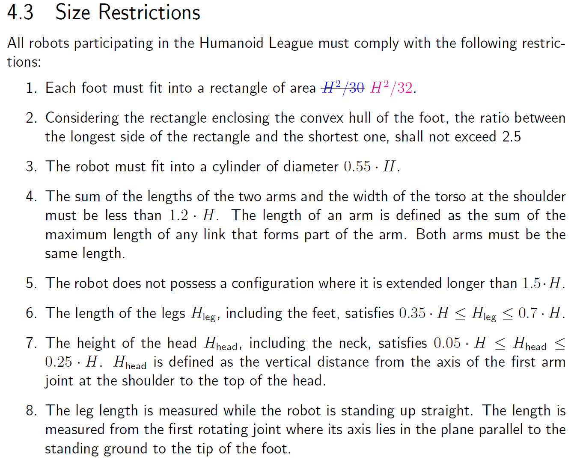
The purpose of the size restriction for maximum foot size (4.3.1) is
to foster the development of dynamically walking humanoid robots and
to have equal challenges for robots of different size in the same HL subleague.
Regarding the challenge for dynamics and postural stability of walking, H_{com} is crucial and H_{top} is irrelevant. However, as the current maximum foot size definition is based not on H_{com} alone but also on H_{top} through 4.1.1, this gives robots with human-like proportions a clear disadvantage because of the factor 2.2 (see also the following example).

Slide 4
Example for Humanoid KidSize
Example Robot 1: H_{top} = 60cm, H_{com} = 28 cm
The maximum allowed foot size according to 4.3.1 is 60² / 32.
Example Robot 2: H_{top} = 60cm, H_{com} = 33 cm
The maximum allowed foot size according to 4.3.1 is 60² / 32.
Both robots have the same maximum allowed foot size, but for robot 2 with human-like proportions (i.e. H_{top} = 1.82 x H_{com}) the challenge of postural stability is made much more difficult.
Robot 2 cannot even use a weightless paper hat to increase H_{top} to achieve a larger feasible foot size comparable to robot 1 with much lower H_{com}, as its H_{top} is already at the upper limit.
A further unintended side effect of the current version of Eq. (1) is that robots with human-like H_{com} are forced by rules 4.3.3-4.3.8 to have smaller proportioned limbs than humans with comparable H_{com}.
Current rule 4.3.1 handicaps robots with human-like proportions. It also discourages the development of better proportioned humanoid robots.
Both effects are not in line with the overall purpose of the humanoid robot design rules.
→ For 2014 a significant revision of this part of the rules is needed.

